Slide 1
Introduction to app development & Flutter
Narayan vyas
Sr. Developer, Flexxited

Slide 2
Mobile app development
Mobile application development is the process of creating software applications that run on a mobile device, and a typical mobile application utilizes a network connection to work with remote computing resources.

Slide 3
App development approaches
Various Technologies are used for Mobile App Development which are classified as –
Native Approach
Hybrid Approach
Cross-Platform Approach

Slide 4
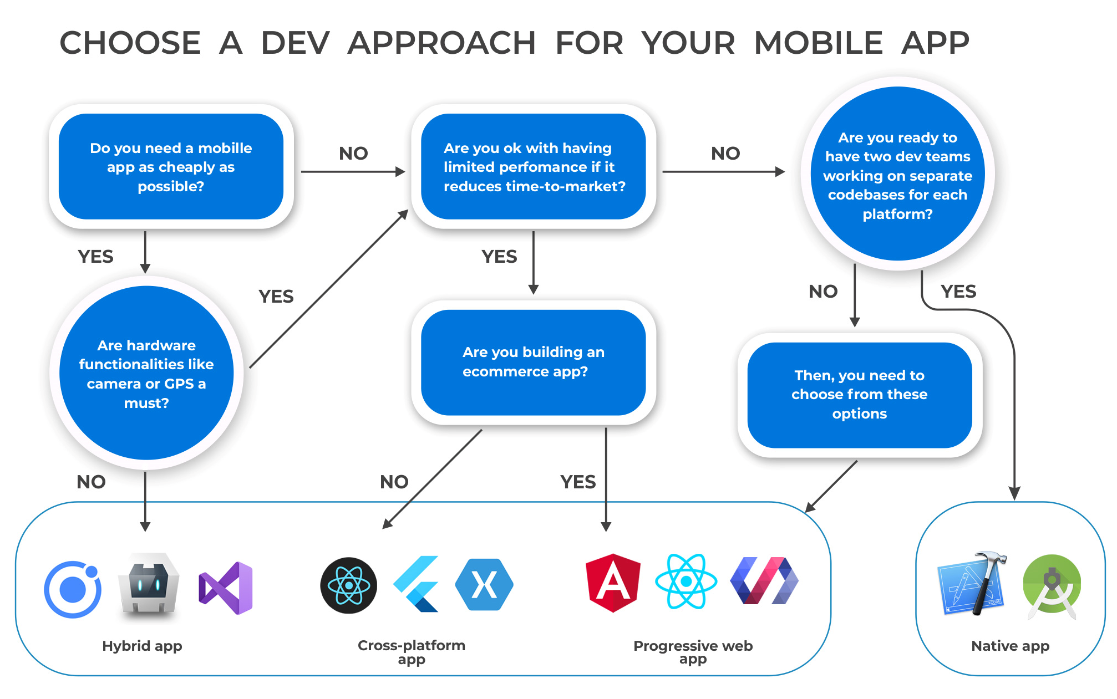

Slide 5
What is flutter?
Flutter is an open-source UI software development kit created by Google. It is used to develop cross platform applications for Android, iOS, Linux, Mac, Windows, Google Fuchsia, and the web from a single codebase.
The first version of Flutter was known as codename "Sky" and ran on the Android operating system.
Initial release date of Flutter was May 2017.

Slide 6
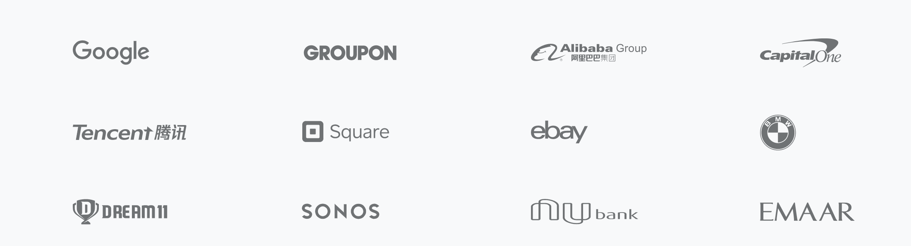
organizations working with Flutter

Slide 7
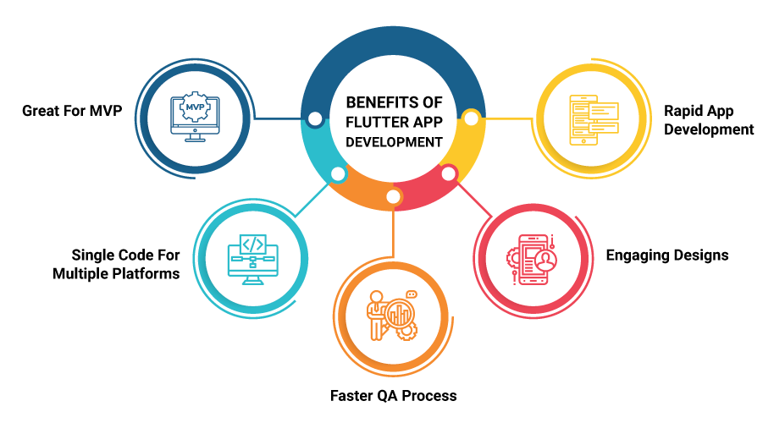
Why flutter

